Slide 1


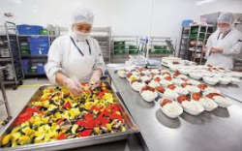
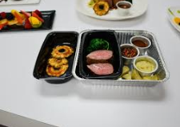
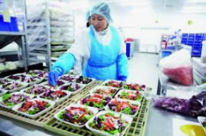
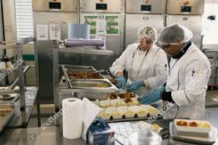
JOB FAIR
Walk-ins welcome!
WHEN: Mon-Fri 1PM-2PM
WHERE: 2755 S 163rd St, SeaTac, WA 98158
Positions:
Local Route Driver (CDL and Non-CDL), Flight Finalizer, Storeroom Clerk, Liquor Packer, Porter
Food Preparer, Dishroom Attendant
Full Benefits
Sign-up bonus
Pay Rates: $16.57 to $21.49
Apply beforehand at www.gategroup.com
Discover the Difference You Can Make at Gate Gourmet!

Slide 2
JOB FAIR
Walk-ins welcome!
WHEN: Mon-Fri, 1PM-2PM
WHERE: 2755 S 163rd St, Seatac, WA 98158
Positions:
Driver, Driver Helper, Flight Checker, Storeroom Clerk, Liquor packer, Porter
Food Preparer, Dishroom Attendant
Full Benefits
Sign-up bonus
Pay Rates: $14.00 to $21.49
Apply beforehand at www.gategourmet.jobs
Discover the Difference You Can Make at Gate Gourmet!

